Slide 1




Hello and welcome!
Name
Job role
Notes:
Index: script in bold. Actions in italic. Click for slide animations marked with an asterisk *.
Hello everyone! Thanks so much for inviting me to speak with you today. My name’s [name] and I work at [company] as a [role]. I also volunteer with BCS, The Chartered Institute for IT, which is all about inspiring and supporting people just like you to get excited about technology.
Today, we’re going to have a chat about why computer science is such a cool subject to get into. Whether you’re thinking about what to study next at KS3, KS4 or even looking to the future considering your options for university, apprenticeships or other training, there’s so much you can do in the world of tech.
So, let’s talk about how you can take your interest in computers, gaming, apps or anything digital and turn it into a career that’s not only fun but also makes a real difference. *

Slide 2


Founded in 1957, Royal Charter in 1984
Mission: Make IT good for society
Raising standards & advancing computing education
Who is BCS?
  Founded in 1957, Royal Charter in 1984
  Leading professional body for IT
  On a mission to make IT good for society
  Offers certifications, resources and networking opportunities
  Leads the Computing at School (CAS) initiative, enhancing computer science education in schools by supporting teachers and students
Notes:
First things first, you might be wondering who BCS even is… * Well, BCS is the professional body for IT, and they’re all about making tech a force for good. Since 1957, it’s been supporting IT pros and setting higher standards in the industry. And something you may be more familiar with (or at least your teachers will be): CAS, or Computing at School, is part of BCS, helping teachers give every student the chance to dive into world-class computing education! *

Slide 3

How do I get into a digital career?
Notes:
Alright, let’s dive in! Have you ever imagined yourself in a digital career?
What do you think of when you think of someone working in tech? Is it someone sitting in front of a computer all day, or is it be someone who’s out and about, collaborating with a team? When you think of someone who works in tech, what do they look like? What do we think? First thing that comes to mind, someone shout out something. [get a few quickfire shout out answers from room]
And what kind of skills and behaviours do you think are needed for someone to work in tech? Is it all about being a whiz with computers? Or do you think there are some other qualities that would be useful… what do we think? [get a few quickfire shout out answers from room]
Ok, great… *

Slide 4




What is computing anyway?
Programming
Coding
AI
Software
Hardware
Networks
Cyber security
Data
Algorithms
Notes:
So, what’s the deal with computing? Computing is all about using technology to tackle problems and get things done. It’s like the brains behind the tech we use every day. *
It involves designing and using systems like computers, software and networks to handle information and make smart decisions.
Think about the apps on your phone, the computers in your classrooms and in every workplace, online shopping, social media, even ordering food in most restaurants nowadays — computing is the driving force behind almost everything we do.

Slide 5









Notes:
Do any of these brands look familiar to you? Can you guess what they all have in common?
Yup, they’re all tech companies. The main thing they need from their employees is strong digital skills.
And here’s the thing: technology isn’t just about computers, smartphones or tablets anymore. It’s everywhere! Tech is shaping the future of medicine, energy, space research, entertainment, transport, fashion and even food.
No matter what field you’re interested in, technology is going to be a big part of it. *

Slide 6


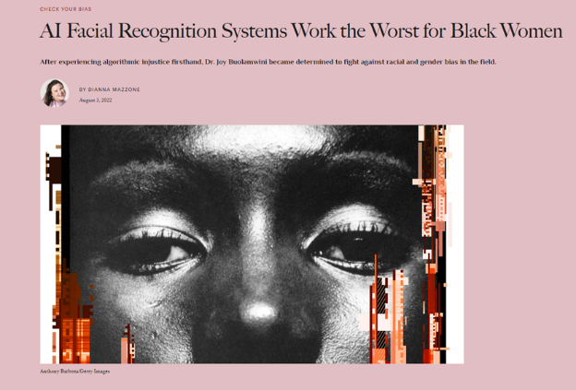

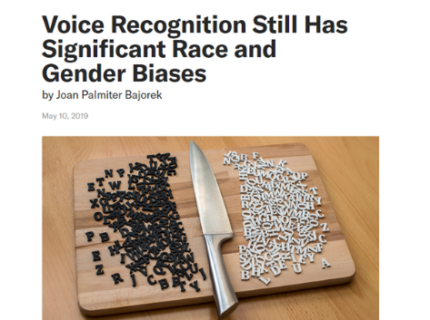
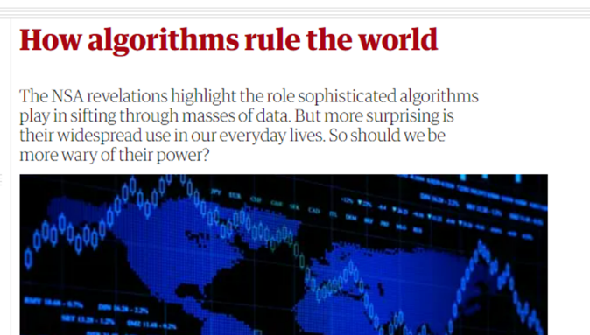
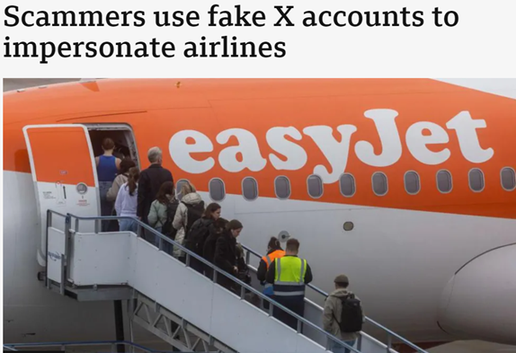
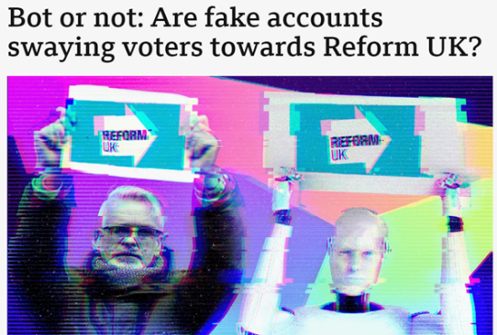
Computing MATTERS
Notes:
Having lots of different people from different background working in computing is more important than ever. Why? * Because, it’s the people in tech that are programming the algorithms that are making important decisions about our lives. And they’re not always perfect. They can carry biases from their creators and the data they use.
So, if these systems aren’t designed with a range of perspectives in mind, they can end up being unfair. For example:
Voice recognition might not always pick up female voices well
Face recognition can struggle with accurately identifying people of colour
Since tech is such a big part of society, it’s so important that the people creating these systems think about everyone’s needs.
Being savvy about the digital world matters too. You might not catch every piece of fake news, but you can learn to choose and use tools wisely to question what you see online.
Understanding and shaping tech isn’t just about coding; it’s about making sure technology works for all of us.

Slide 7

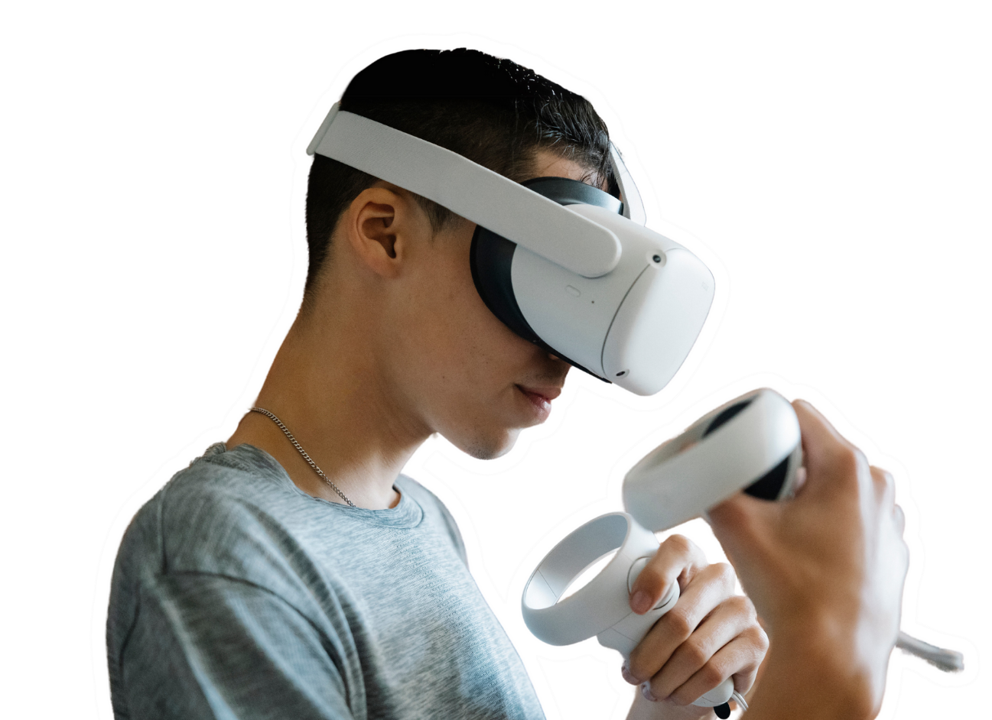
Close your eyes and raise your hand if you think...
Notes:
…ok, so now we’re going to do a quick little exercise. I’m going to read out three statements and I want you to think about which one feels closest to how you’re feeling.
Everyone ready? Ok, here we go:
Number 1. What’s the point of computer science? I already know how to use my phone and a computer. I just wish it was the weekend so I didn’t have to be here…
Number 2. I see why computer science is useful, but I just don’t see myself choosing it for A-levels or working in tech in the future…
Number 3. It’s actually pretty cool learning how tech works, especially since it’s so important in everything these days. I could see myself taking it further.
Okay, now I’m going to read them out again and this time I want you all to close your eyes and raise your hand when you hear the one that sounds like you. Don’t worry, everyone's eyes will be closed so you won’t be influenced by anyone else and no one will see which you choose.
[Read points again and pause as students respond]
Fab! Ok you can open your eyes now. Very interesting… it’s good to see a lot of you want to learn more about tech... a few of you are counting down to the weekend already — totally understandable… and it looks like some of you can’t really see yourselves working in tech at all.
I wonder why that is? Is it because you’re not really interested? Or maybe you feel like you don’t quite fit the typical 'tech' image? You don’t think you have the right skills or passions? Well, let’s talk about that… *

Slide 8
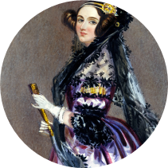

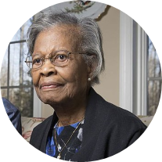
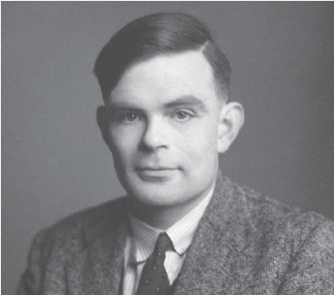
What do these people have in common?
#thisisacomputerscientist
Notes:
I want you to take a look at these people… * what do you think they all have in common? Any guesses?
[Pause to see if anyone responds]
You got it… * all of these amazing and very different people are computer scientists. *

Slide 9


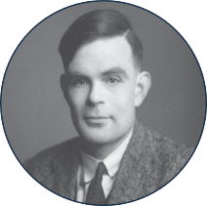
Revollutionised network routing protocols for the internet
Invented the Turing machine and cracked the Enigma code in WWII
Ada Lovelace
Tim Berners-Lee
First computer programmer
Created the World Wide Web and heads web standards group W3C
Gladys West
Alan Turing
Pioneered GPS technology
#thisisacomputerscientist
Notes:
Let's take a closer look at these incredible people. I’ve chosen these people specifically because their work forms the foundation of many technologies we use today.
So, does anyone recognise any of them? [Pause for responses]
Let’s go one by one. [See if anyone can guess the names and if not reveal the name] * [click to reveal each name]
Now, shall we see if we can match each person to their achievements? * You can vote by raising your hand, or I might call on some of you to give it a shot. [Encourage participation and click to reveal their achievements after guesses. When you reveal the answers read out a little more information about each person]
* Ada Lovelace worked with Charles Babbage on the Analytical Engine, which was one of the first ever computers. But she didn’t just help design this computer — she wrote the very first computer program for it… before it even existed! Imagine that: programming a machine that didn’t even exist yet.
* Tim Berners-Lee is the mastermind behind the World Wide Web, which he created in 1989 while at CERN. Now, he’s all about keeping the internet open and free, leading the Web standards group, W3C, to make sure it stays that way.
* Gladys West played a key role in creating GPS technology. Her work involved complex math to model the earth's shape, which made GPS much more accurate and reliable. So, we can thank her for google maps and all our GPS developments.
* Alan Turing is often called the "father of computer science," He invented the Turing machine, a key idea for modern computing and he also helped crack the Enigma code in WWII, which quite literally changed the course of history.
All of these people are so different… and yet they’ve had a huge impact on our technology today. There’s no one-size-fits-all when it comes to being a computer scientist. It doesn’t matter what you look like or what your interests are — each of you has the potential to make your mark in tech. *

Slide 10

There are many different pathways into a digital career...
Whatever you love and whichever path you choose, you can succeed in a digital career
Notes:
What’s so great, is there’s no one way to get into tech. There are so many different pathways, qualifications or experiences you can take. You don’t have to follow just one path to get started.
And it doesn’t matter what you’re interested in. Whether it’s coding, design, data or something entirely different and whether you learn better by studying or you’re more of a hands on and learn on the job kind of person… regardless, there’s a bright future in tech waiting for you. *

Slide 11







Soft skills are just as important as technical skills!
Creativity
Communication
Teamwork
Time management
Problem-solving
Analytical thinking
Notes:
When we think about working in tech, it's easy to focus on those technical skills like coding, maths, science, data analysis. But here’s the thing: skills like communication and problem-solving are just as important! * These kind of skills are called ‘soft skills’ — and they’re crucial in the world of tech.
You might already have some of these key soft skills that the industry is looking for. Don’t worry if you’re not a tech expert yet — those technical skills can be learned. Your existing skills are valuable and they can be a great foundation for a digital career. *

Slide 12
















Software developer
UX/UI designer
SEO specialist
Cloud architect
Computing teacher
Digital marketer
Cyber specialist
IT support technician
Technical writer
Entrepreneur
Web developer
Content creator
Business analyst
DevOps engineer
AI/ML engineer
Notes:
Working in tech isn’t just about programming. There are many roles in tech that you might not have even thought of. Can anyone think of any roles that involve computer science? [give them 30 seconds to shout out any roles they can think of]
* Did you think of any of the roles we have here? [give them 30 seconds to look at the roles] *

Slide 13


Which tech job is right for me?
Take our quick quiz to find which tech roles match your answers, based on real industry professionals!
Notes:
So, with so many options available… are you wondering which tech role might be right for you? Well, BCS actually have a quiz to help you find out just that. It asks you about your interests and skills and then matches you with real tech roles that could be a good fit.
It’s a great way to see how your skills and interests might align in the tech world. It also gives you a rundown of the top three skills you might need, potential salaries and gives you some resources to help get started. For example.. [click to play promo video]
Make sure you give it a go — you might find out about a role you hadn’t considered before! *

Slide 14


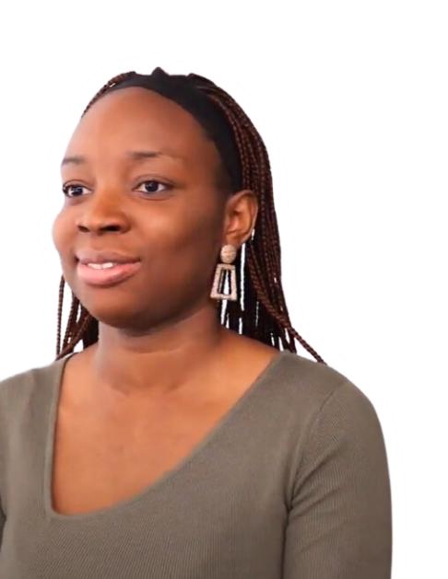
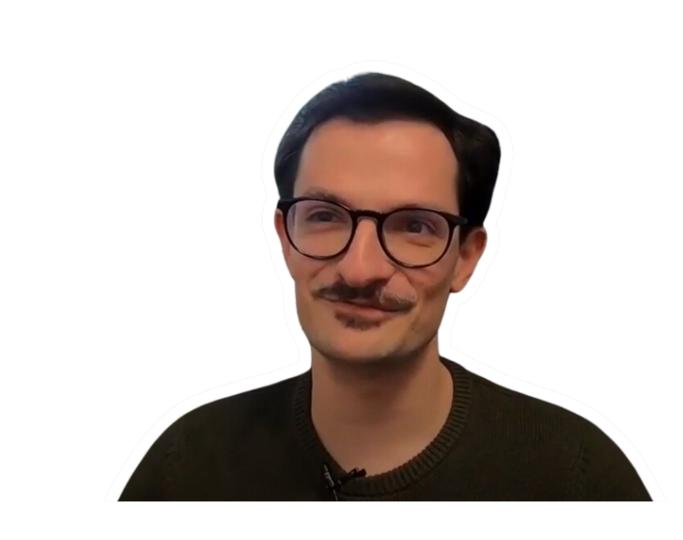

Watch a day in the life of a...
Graduate digital consultant
Senior software
engineer
Notes:
Now it’s all very well and good, me telling you what a role in tech might be like… but it’s far more valuable to hear from real people. So, let’s hear from some real people who work in the industry. [click to play videos] *

Slide 15


My career in tech...
[insert headshot image]
What do I do?
[brief summary of your job including job title and company name]
What do I enjoy the most about my job?
[one or two things you enjoy most about your job]
How did I get to where I am today?
[brief summary of how you got into your job could include what subjects you studied, degree, apprenticeship etc.]
Notes:
As we’re hearing from a few people’s journey into tech, I thought I’d give you a quick summary of mine as well… As I said before I’m a [job title] and I work for [company name]. [Provide a little overview of your job role and how you got into it]

Slide 16

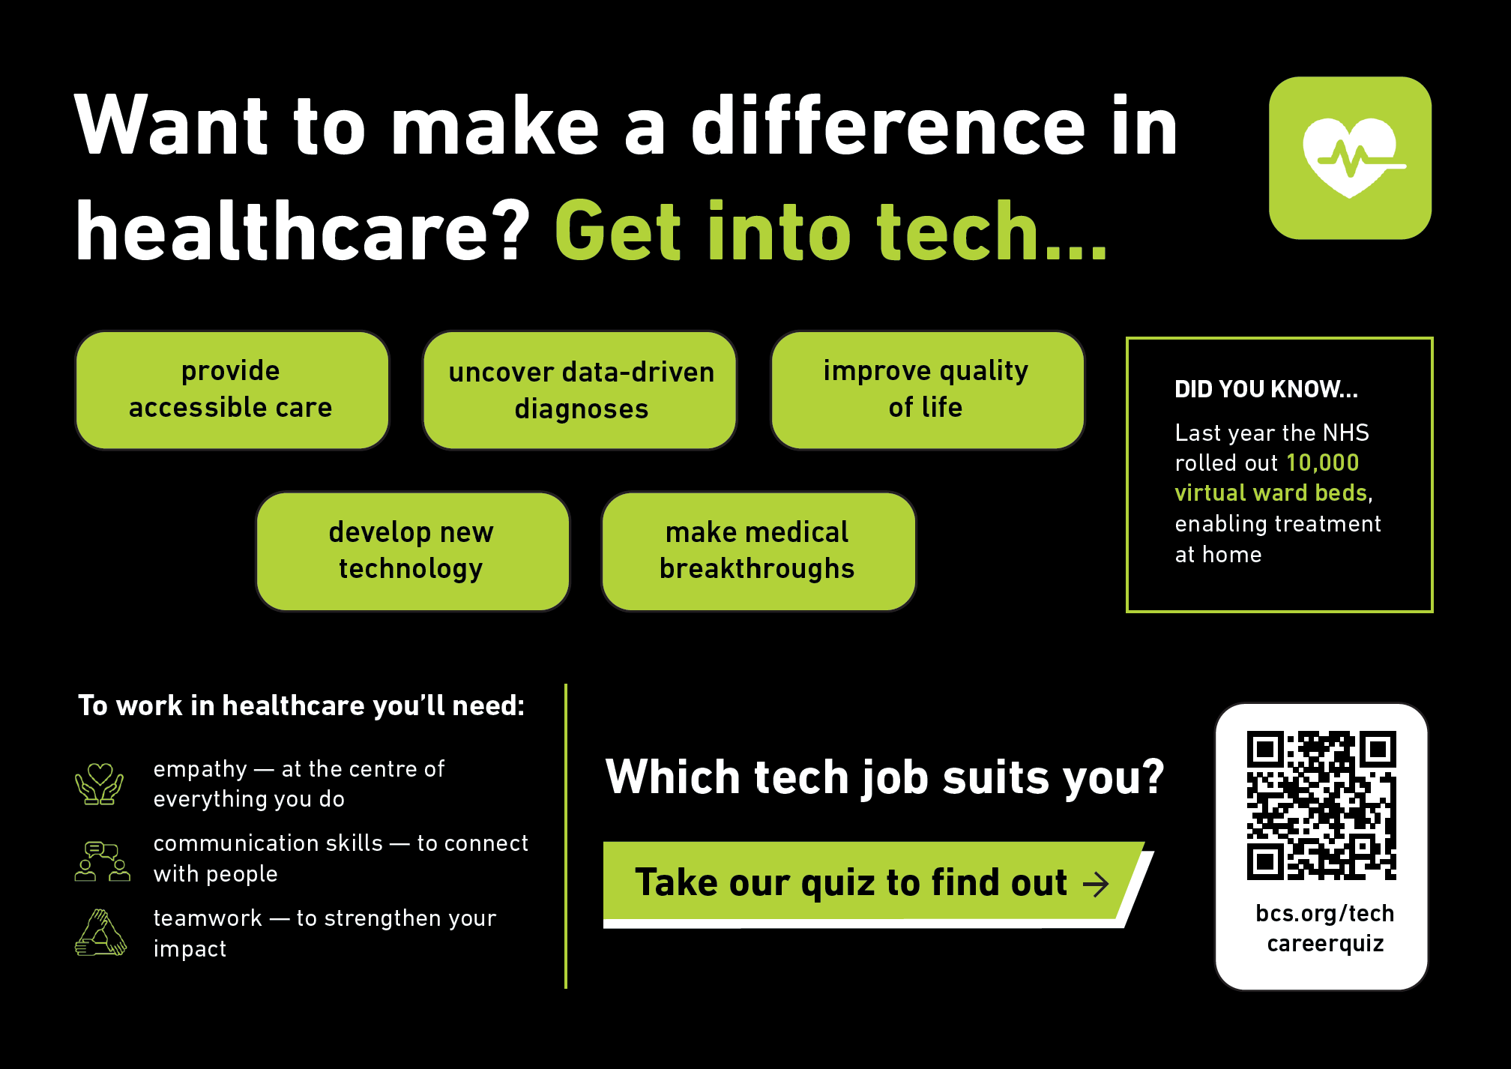


Notes:
What’s really cool, is tech jobs aren’t just in big tech companies; they’re everywhere! From keeping our healthcare systems running smoothly to bringing your favourite Netflix shows to life, technology plays a huge role in all sorts of unexpected places. Here are a just few examples you may not have thought of…
Tech pros in healthcare work on everything from creating cutting-edge medical devices to developing software that helps doctors diagnose and treat patients more effectively. *

Slide 17
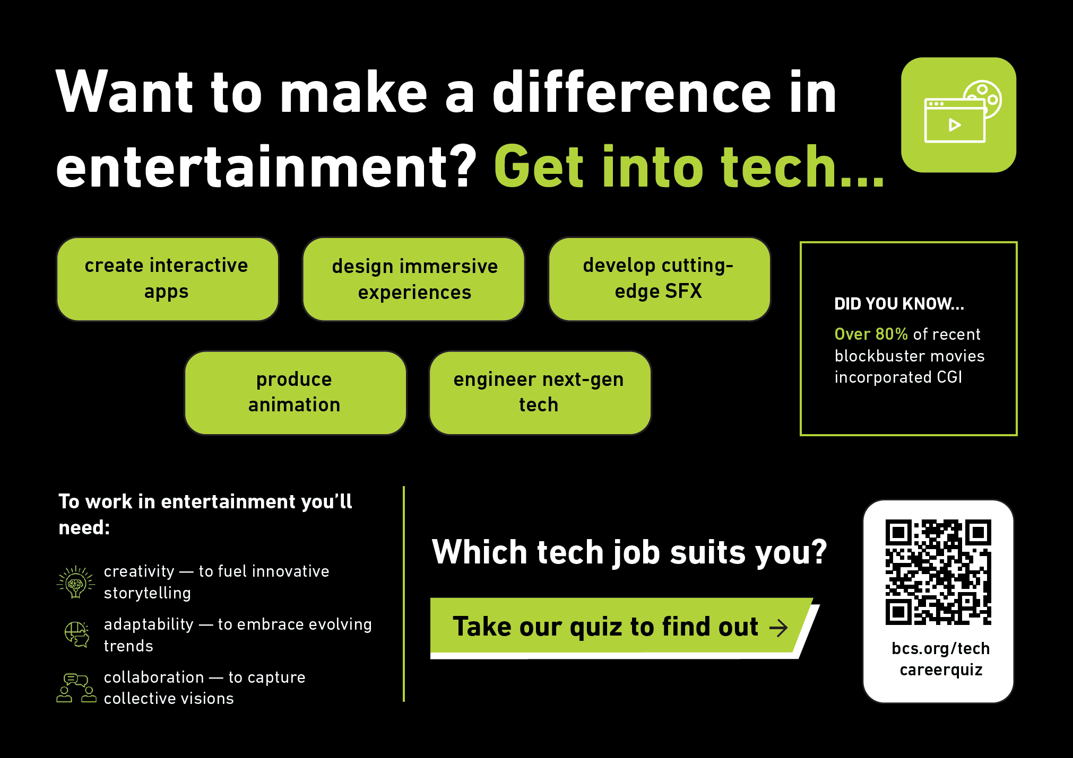

Notes:
In the entertainment world, techies design video games, develop special effects for movies and even create the algorithms that recommend your next binge-watch. *

Slide 18
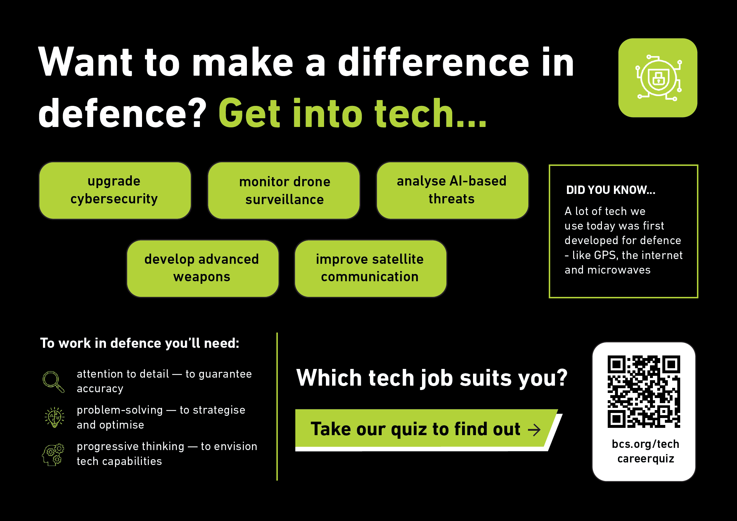

Notes:
In defence, tech experts work on cybersecurity to protect critical information, develop advanced surveillance systems and create simulations for training purposes. *

Slide 19

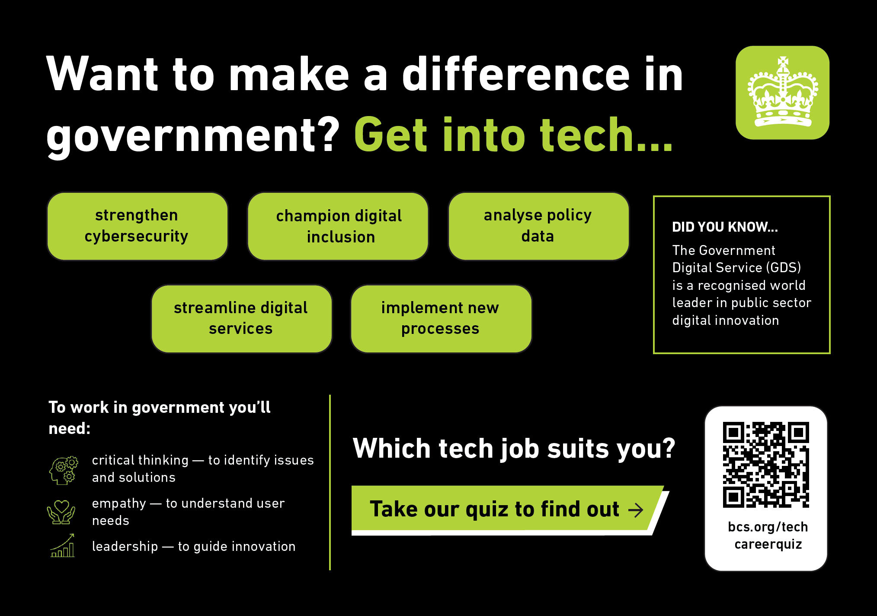


Notes:
Government tech roles involve developing systems for public services, managing data for policy-making, and improving digital access for everybody. And there’s so many more…. no matter what industry you're interested in, there’s likely a tech role that can make a real difference. *

Slide 20
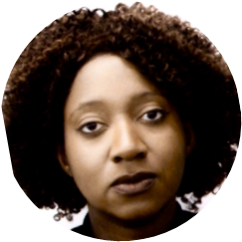



What careers advice would you give to people wanting to get into tech?
The more skilled and experienced you are the more competitive and highly sought after you will be as a candidate and should be able to transition from entry level to at least mid-level in 5 years. Having additional skills like SQL , Python & project management are real bonuses and mean you can transition into other careers such as Data Science and Data Engineering.
Don’t give up if you have failures in your life. I completely failed my A Levels went to university. To later find out I am dyslexic and I made it to Director in one of the biggest banks in the world. Hard work, determination and belief in yourself will make your dreams come true.
Marsha — Data Analyst, UK Civil Service
Hena — Director of Strategic Development, Barclays
Notes:
Getting advice from people who’ve been there and done that is always a great way to navigate your own journey. We asked some tech pros for their top tips and here’s what they shared:
Marsha thinks building lots of skills and getting different experiences can really give you a leg up.
Hena says to work hard, stay determined and keep going even when things get tough. Believe in yourself and don’t let failures stop you! *

Slide 21


The UK Government's 2024 Digital Strategy revealed that over 80% of jobs need digital skills. They estimate that the skills gap
costs the economy
up to £63 billion a
year in lost
potential GDP.
Let’s bust some myths...
Tech is all about coding and nothing else​
You’ll be sat at a computer all day
You have to be good at maths
You need a degree to work in tech
Notes:
There are definitely some stereotypes about the types of people who work in tech and these outdated ideas that might impact your decision to get into the industry. So, let’s clear up a few myths:
Think tech is all about coding? * Think again! While coding can be important in certain jobs, soft skills like communication, teamwork and problem-solving are just as crucial. Tech careers need you to see the bigger picture and work well with others.
Worried about being stuck at a computer all day? * Don’t worry, you won’t be… many tech jobs are dynamic and involve collaborating with others, designing, testing and attending meetings. It’s not all screen time!
Heard you need to be a maths whiz to get into tech? * Not necessarily. While maths can be useful, many tech roles focus more on creativity, problem-solving and logic than advanced math skills.
And if you think you need a degree to break into tech, think again! * There are tons of path s— skills, experience, apprenticeships and training programs can all open doors to your dream job.
Let’s break those stereotypes and see tech for what it truly is — an industry open to everyone! * Plus, with over 80% of jobs now requiring digital skills, it’s crucial for the next generation (that’s you!) to be prepared. Computer science isn’t just about coding; it’s about readying yourself for the future job market. *
Source - https://hwrkmagazine.co.uk/girls-gcse-computing/#:~:text=This%20year%20fewer%20girls%20took,32.2%20percent%20of%20male%20entrants.

Slide 22



What does it take?
1
2
3
I CAN DO IT
RELEVANT TO ME
I BELONG
Notes:
Success boils down to three things:
Believing you can do it *
Seeing the relevance of computing in your life and your future *
Feeling that tech is for you and you belong in this field *
Keep these three things at the core of your journey to guide you through challenges and keep you focused on your goals. *

Slide 23

The growth mindset
You have to...
  embrace challenges
  persist in the face of setbacks
  put in the effort
  get inspired by success
Notes:
Not everything worth achieving comes easily. * Embracing a growth mindset means seeing challenges as chances to improve and learn. When you hit obstacles, view them as opportunities to grow rather than setbacks.
Think about some of the people we’ve heard from today. Their stories and journeys can inspire you and show you that success often comes through persistence and learning. Use their experiences as motivation to push through your own challenges and keep moving forward. *

Slide 24


Qualification pathways
Level 3
Level 4-6
Level 7-8
A level CS
Uni degree
Post grad
Digital apprenticeships
T level
Modular courses to build your knowledge, skills and experiences
Notes:
So, what about the different paths you can take to start a digital career?
First off, this is a rapidly growing field — over 36,000 students took digital courses in 2023 alone! There are so many different courses that can lead to a variety of careers like a software developer, telecommunications engineer, UX designer, data scientist, computer games developer, cyber intelligence officer or data analyst. And with 80% of universities offering these courses, you have plenty of options to choose from.
But if you're more hands-on, you might want to do an apprenticeship instead. In 2021, more than 36,000 people started Digital and IT apprenticeships. These programs also lead to exciting careers, offering a mix of work and classroom experience. Plus, you get to earn while you learn! You'll find opportunities with a wide range of employers, including Sky, BBC, Google, LIDL, BMW, Specsavers, Coca-Cola, British Airways, Starbucks, Cisco, Amazon, Unilever, Hilton, the Royal Air Force and many, many more. *

Slide 25







Possible subject combinations...
Psychology
Applied criminology
Computing
Religious studies
Architecture
Physics
Electrical engineering
History
Law
Notes:
And if you’re looking to take the qualification route, you don’t have to stick with just science subjects to study computing. You can pair it with whatever excites you and open up a bunch of new career doors! *
Love art? Combining computing with design could lead you to a cool career in digital media or graphic design. Got a business mindset? Mixing computing with business studies could set you up for roles in tech management or even starting your own business.
Think of computing as a tool that can enhance any field you’re passionate about. It makes your studies more interesting and gives you a ton of career options to explore. Don’t be afraid to mix computing with what you love! *

Slide 26




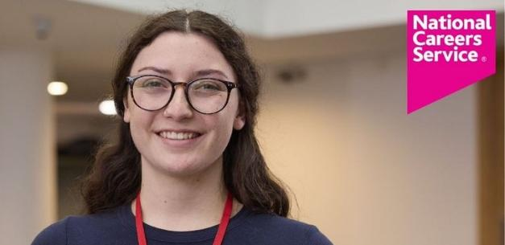


getmyfirstjob.co.uk
prospects.ac.uk
Helping young people find their first job or apprenticeship
skillshare.com
Providing career advice and job listings for professionals
Offering online courses to learn new skills creatively
gov.uk
The UK government’s official website for public services
worldskillsuk.org
nationalcareers.service.gov.uk
Spotlights and boosts top talent through exciting skills competitions
Giving guidance and resources to help with career planning and job searches
https://bit.ly/BCSdigitalcareer
Notes:
As we wrap up and reflect on the amazing journeys and advice we’ve explored today… I think we can all agree that tech offers exciting opportunities for everyone. So if you’re interesting in finding out more, here are a couple of resources that can be great starting points for your career journey.
There’s everything from building skills and taking online courses to finding job opportunities and apprenticeships. Plenty of options to explore!
And don't forget about the BCS careers quiz, videos and career information I’ve shared today. You can scan the QR code to check out the BCS careers info and see what’s next for you. *

Slide 27


So, who’s thinking
about a digital career?
https://bit.ly/BCSdigitalcareer
Notes:
That’s it from me today… I hope that at least some of you are now considering taking computer science as one of your a career journey in tech. Does anyone have any questions?

